Slide 1
Advance Internship@Clevered AI Powered AI Personal Finance Management System
App User Manual
Author: Akshin Gupta

Slide 2
Table of Contents
Acknowledgement
My Introduction
My Experience With Clevered
About My App
App functions
Contact Information

Slide 3
Acknowledgements
A small vote of thanks for all who have helped you in this journey of App Development – your parents, Mr Ken, Clevered, Mentors, Group Members, Friends, Sites etc.

Slide 4
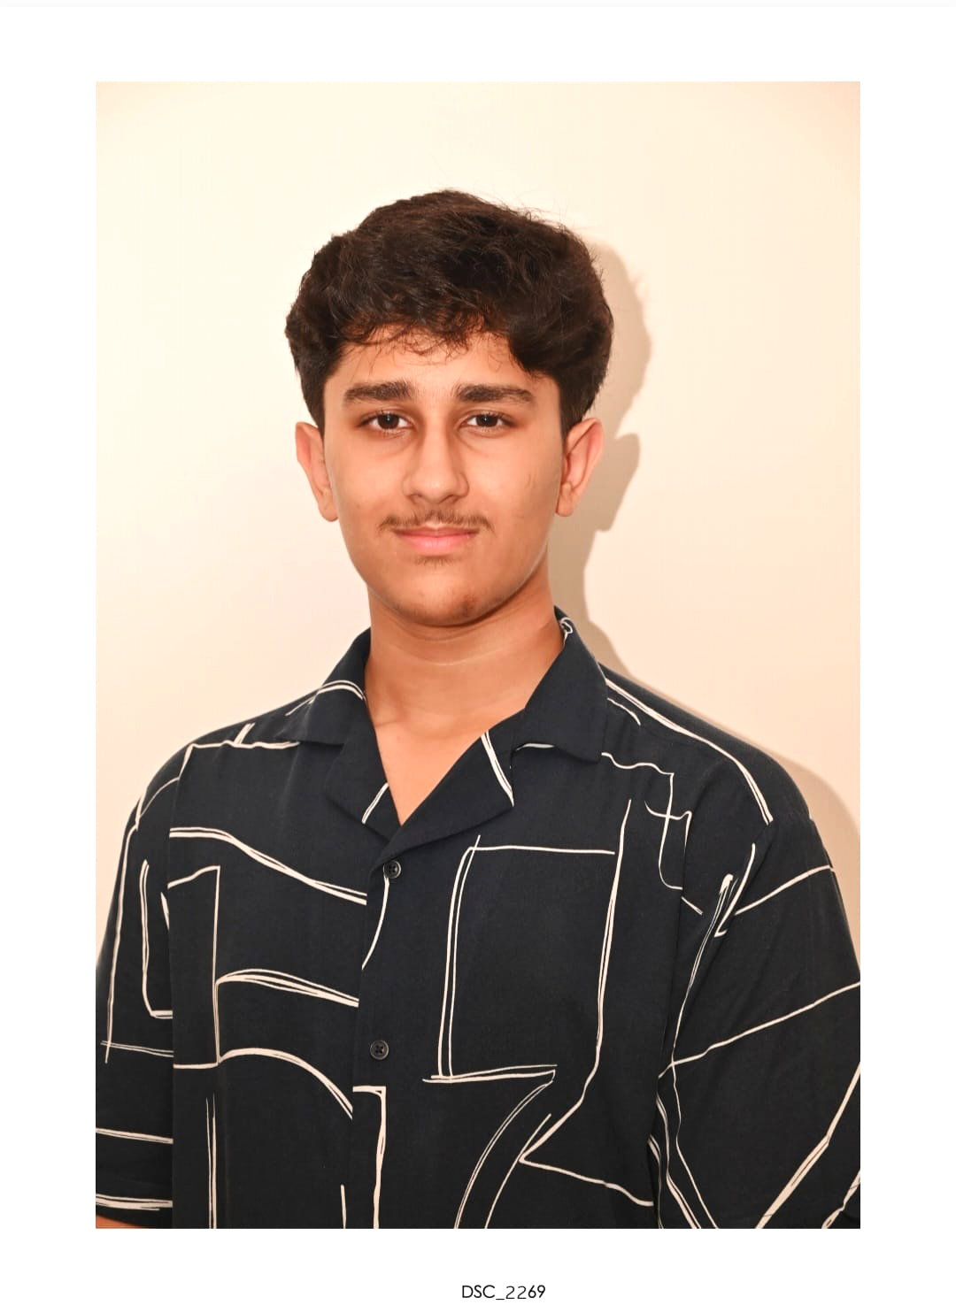
About Me..
Student’s Photograph
Hi, I’m Akshin Gupta,
a Grade 11 student from DPS-MIS, Doha.

Slide 5
About My Internship with Clevered..
My experience with Clevered:
I enjoyed learning about so much more about Python. I had learnt things that I had never dreamt of learning.
Badges earned:
Rockstar for attentiveness
Rockstar for wonderful efforts in project completion

Slide 6
About App
The app’s main menu offers three intelligent financial tools that empower users to manage their finances effectively:
Track Your Expenses – Analyze and visualize how your money is spent.
See Money Tips – Get AI-curated financial guidance to improve savings.
Investment Strategies – Explore strategic investment opportunities for growth. Together, these features create a complete ecosystem for financial awareness and improvement.
The AI-Powered Personal Finance Management System is designed to help users make smarter financial decisions using automation and data visualization. The app tracks expenses, provides expert financial tips, and suggests investment strategies, all within an intuitive interface. Its goal is to simplify financial planning and promote smarter money habits through AI-driven insights.

Slide 7
How do I use the App?

Slide 8
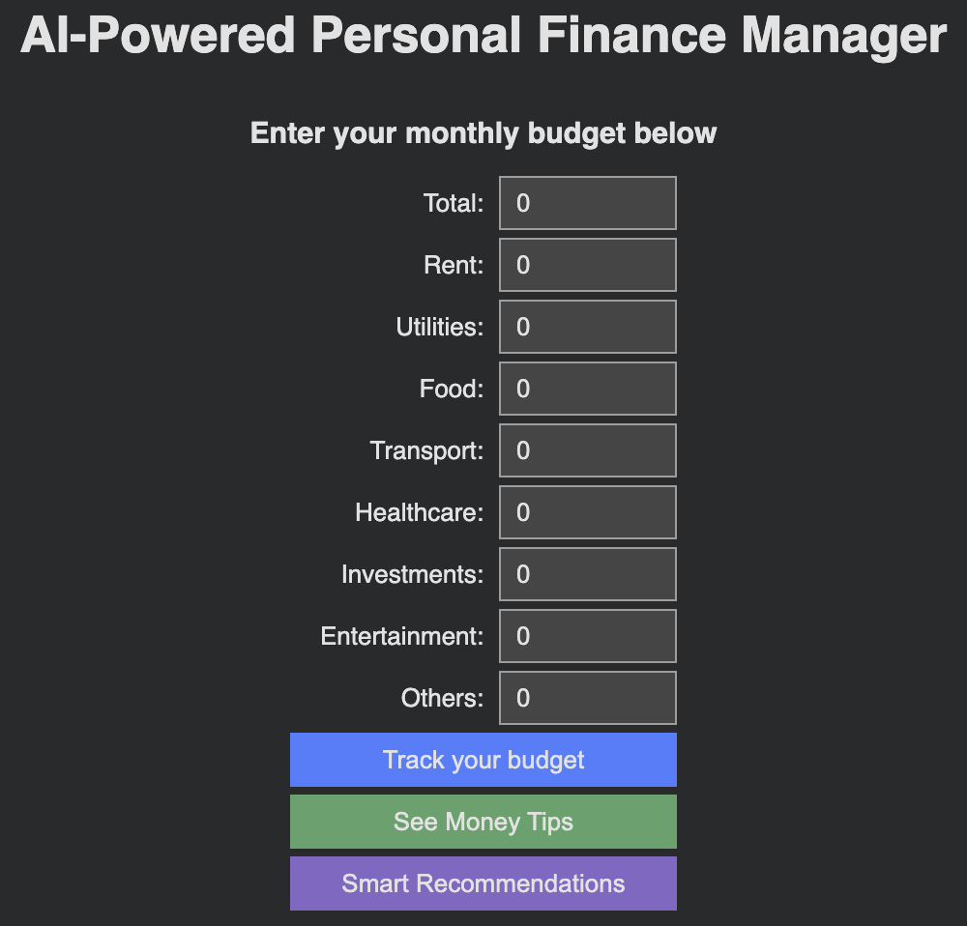
Track Your Budget
Steps to Use:
Enter your total monthly budget and category expenses.
Click “Track Your Budget”.
View a detailed table and pie chart showing spending and savings.

Slide 9
See Money Tips
Steps to Use:
Click “See Money Tips”.
Read practical budgeting tips to manage your money effectively.

Slide 10
Smart Recommendations
Steps to Use:
Click “Smart Recommendations”.
Get actionable advice on adjusting spending, saving more, and investing wisely.

Slide 11
Contact Person
Please reach out to Akshin Gupta at akshingupta27@gmail.com for any questions/ concerns/ suggestions on the App

Slide 12
Thank you!

